Slide 1

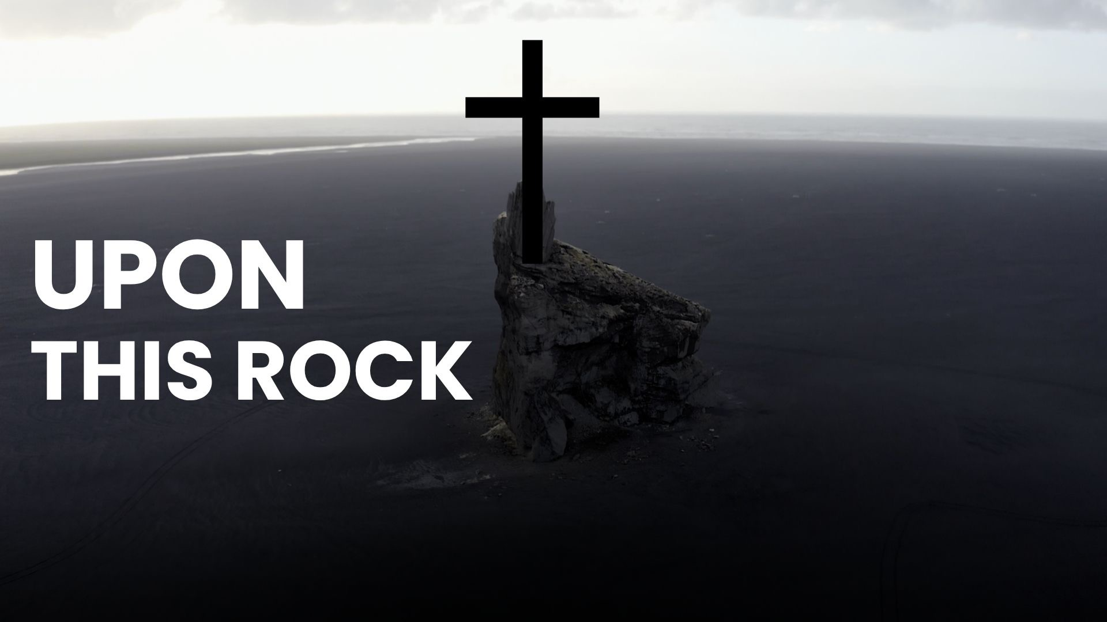
Upon This Rock (Core Values)

Slide 2
Cedar Grove Baptist Church exists to create a space where people and families can meet Jesus, find community, and grow in their faith.

Slide 3
Our purpose is to love others unconditionally, learn about God increasingly, live to share Jesus intentionally and lead others to Christ continually in Lebanon, TN and throughout the whole world.

Slide 4
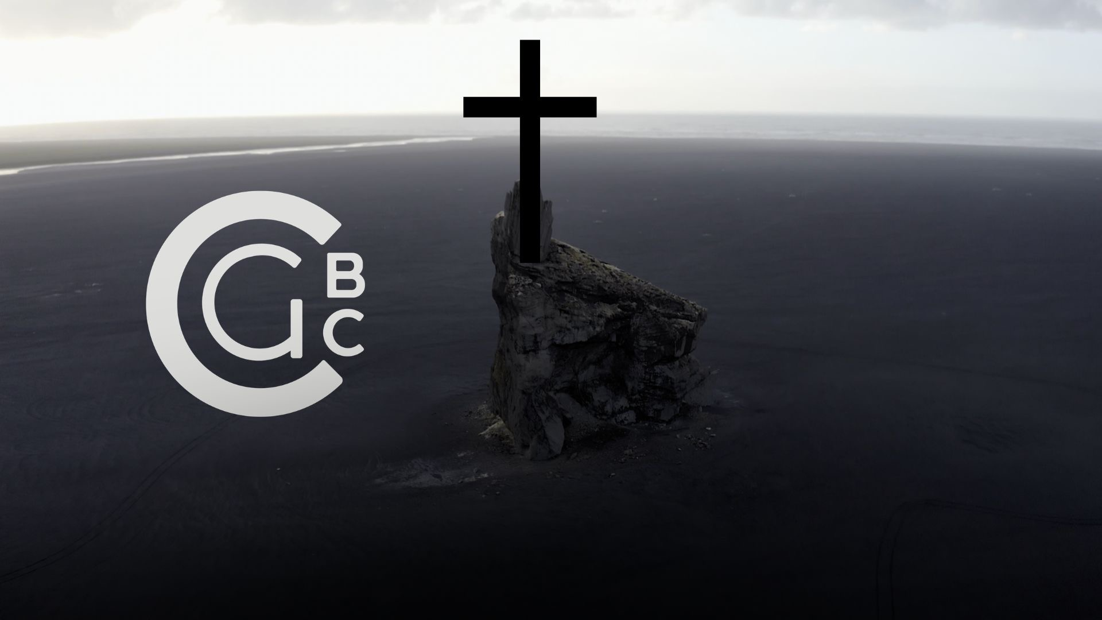

Slide 5
I will uphold the sanctity of the family

Slide 6
I will live daily with integrity in thought, word, and deed.

Slide 7
I will build and grow each of the four relationships represented in the purpose statement of my church.

Slide 8
Commitment

Slide 10
I will wholeheartedly commit myself to the purpose and mission of my church.

Slide 11
By attending faithfully

Slide 12
25 Not forsaking the assembling of ourselves together, as the manner of some is; but exhorting one another: and so much the more, as ye see the day approaching.
Hebrews 10:25
KJV 1900

Slide 13
ἔθος (ethos), custom, practice, habit
Dictionary of Biblical Languages with Semantic Domains: Greek (New Testament)

Slide 14
23 Let us hold fast the profession of our faith without wavering; (for he is faithful that promised;) 24 And let us consider one another to provoke unto love and to good works:
Hebrews 10:23–25
KJV 1900

Slide 16
25 Not forsaking the assembling of ourselves together, as the manner of some is; but exhorting one another: and so much the more, as ye see the day approaching.
Hebrews 10:23–25
KJV 1900

Slide 17
By giving cheerfully

Slide 18
21 For where your treasure is, there will your heart be also.
Matthew 6:21
KJV 1900

Slide 20
10 “Bring the whole tithe into the storehouse, so that there may be food in My house, and test Me now in this,” says the Lord of hosts, “if I will not open for you the windows of heaven and pour out for you a blessing until it overflows.
Malachi 3:10
NASB95

Slide 21
When we give generously and intentionally we lift the burden of financial limitations on magnifying the ministry of this local church.

Slide 22
34 Neither was there any among them that lacked: for as many as were possessors of lands or houses sold them, and brought the prices of the things that were sold, 35 And laid them down at the apostles’ feet: and distribution was made unto every man according as he had need.
Acts 4:34–37
KJV 1900

Slide 24
36 And Joses, who by the apostles was surnamed Barnabas, (which is, being interpreted, The son of consolation,) a Levite, and of the country of Cyprus, 37 Having land, sold it, and brought the money, and laid it at the apostles’ feet.
Acts 4:34–37
KJV 1900

Slide 25
7 Each one must do just as he has purposed in his heart, not grudgingly or under compulsion, for God loves a cheerful giver.
2 Corinthians 9:7
NASB95

Slide 27
By working diligently

Slide 28
4 The soul of a lazy man desires, and has nothing; But the soul of the diligent shall be made rich.
Proverbs 13:4
NKJV

Slide 29
4 The soul of a lazy man desires, and has nothing; But the soul of the diligent shall be made rich.
Proverbs 13:4
NKJV

Slide 30
soul, living being, life, self, person, desire, appetite, emotion, and passion
Enhanced Brown-Driver-Briggs Hebrew and English Lexicon

Slide 31
58 Therefore, my beloved brethren, be steadfast, immovable, always abounding in the work of the Lord, knowing that your labor is not in vain in the Lord.
1 Corinthians 15:58
NKJV

Slide 33
3 Commit your works to the Lord And your plans will be established.
Proverbs 16:3
NASB95

